Slide 1


Fabric demo with AdventureWorks dataset
by Bryan Deckers & Nathan Neve

Slide 2

Contents
Data Model
Master Pipeline
Landing Bronze
Bronze to Silver
Silver to Gold
Teams & Mail

Slide 3
Data Model

Slide 4
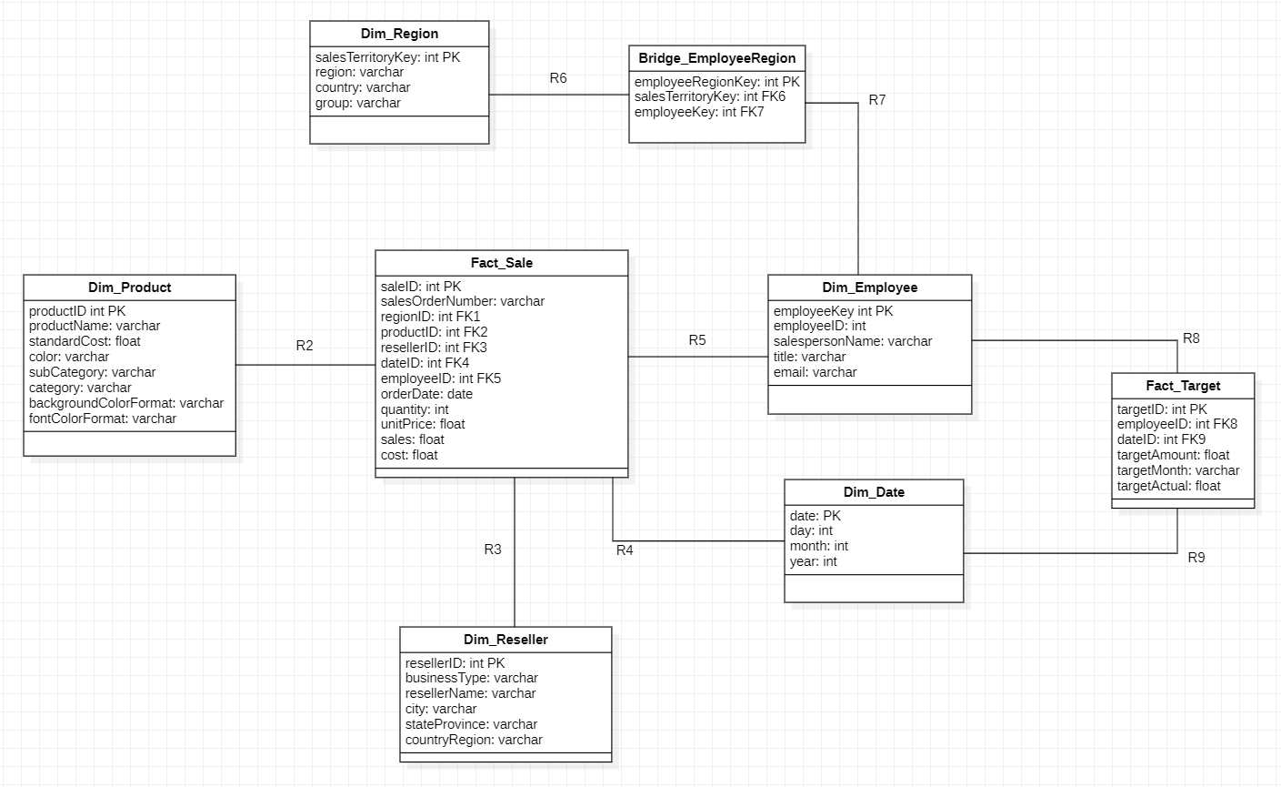

Slide 5
Master Pipeline

Slide 6
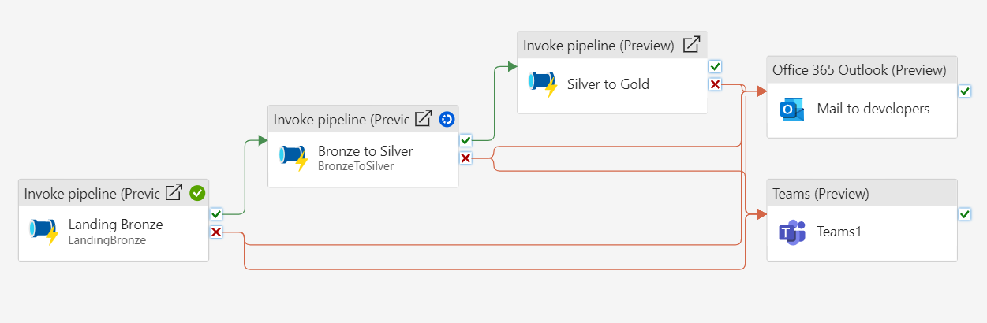
Master Pipeline

Slide 7
Landing Bronze

Slide 8
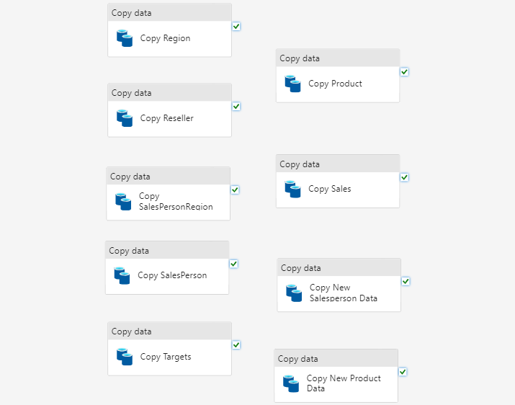
Landing Bronze
A series of copy statements that load the csv files of the source into the bronze layer.

Slide 9
Bronze to Silver

Slide 10
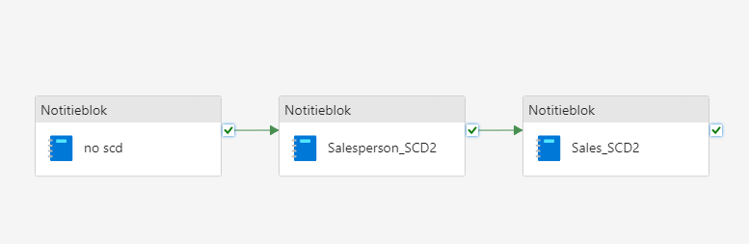
Bronze to Silver,
Running the notebooks in parallel can improve execution speeds drastically. We had a limited capacity, so we had no choice.

Slide 11
Three notebooks serving a different purpose
In bronze to silver we specify our data types, change column names and clean our data.
no scd: loads the csv’s inside our silver layer without applying SCD.
Salesperson_SCD & Sales_SCD: load the csv’s inside our silver layer while applying SCD type 2.

Slide 12
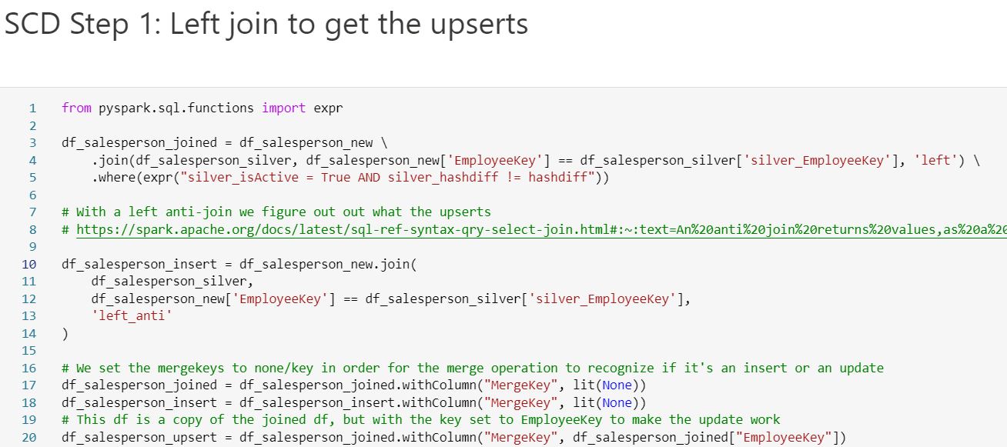
SCD Type 2 logic

Slide 13
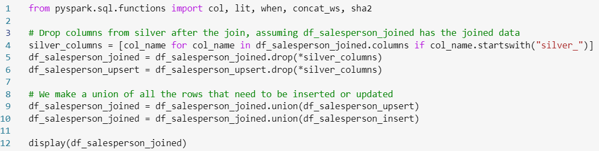
Finally we remove the silver_ aliased columns
and perform a union

Slide 14
Silver to Gold

Slide 15
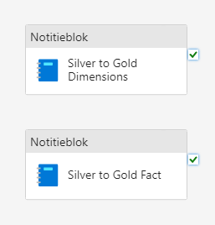
Silver to Gold
These two notebooks serve the purpose of creating the dimensions and fact tables respectively.

Slide 16
Teams & Mail

Slide 17
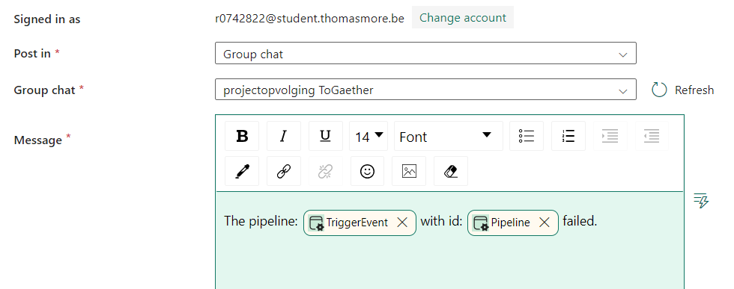
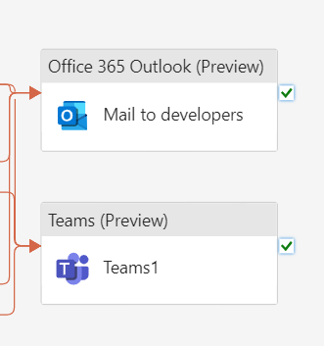
Teams message when the master pipeline fails

Slide 18
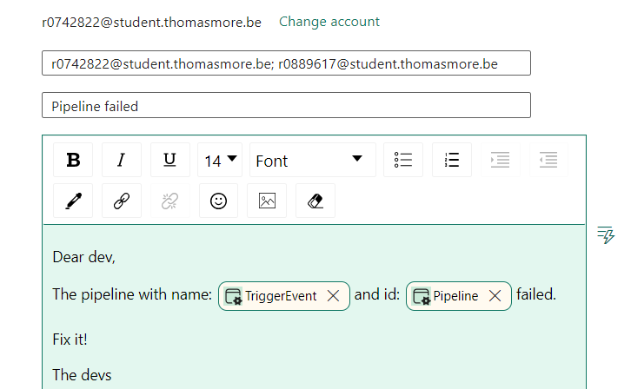
Mail when the master pipeline fails

Slide 19
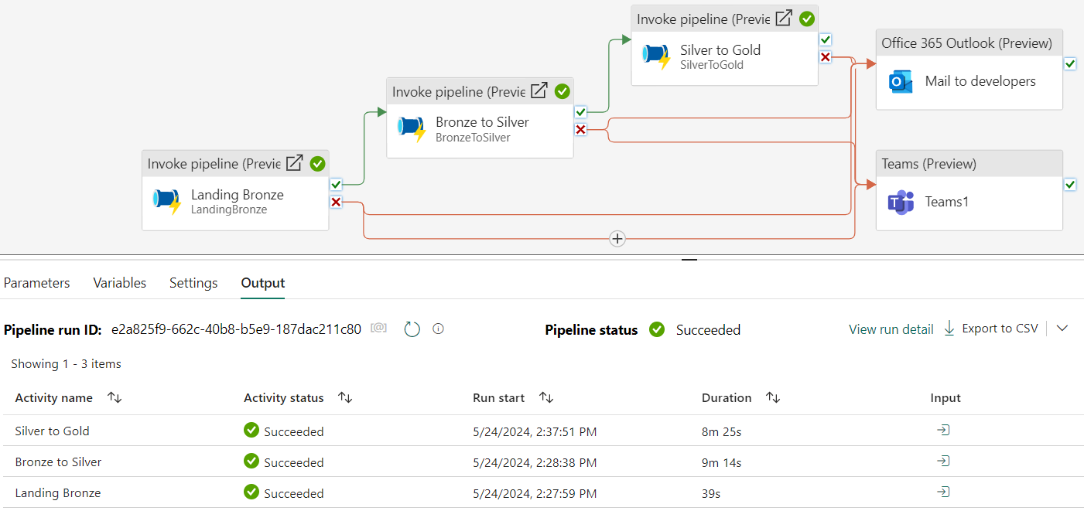
Successful execution

